Slide 1

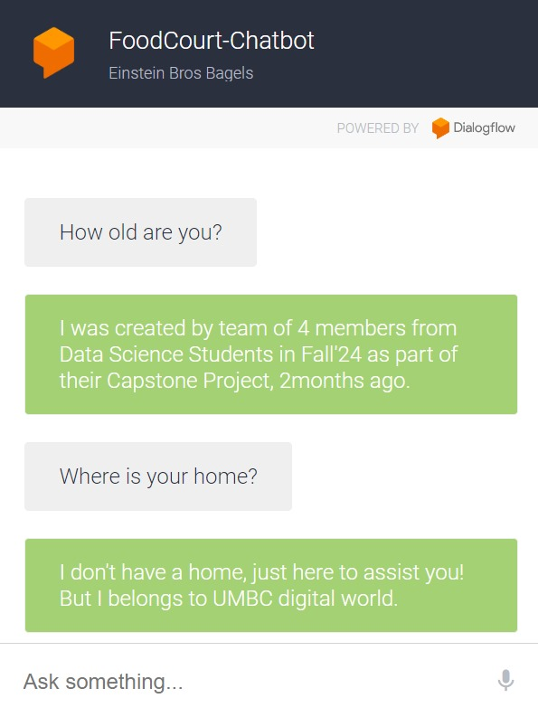
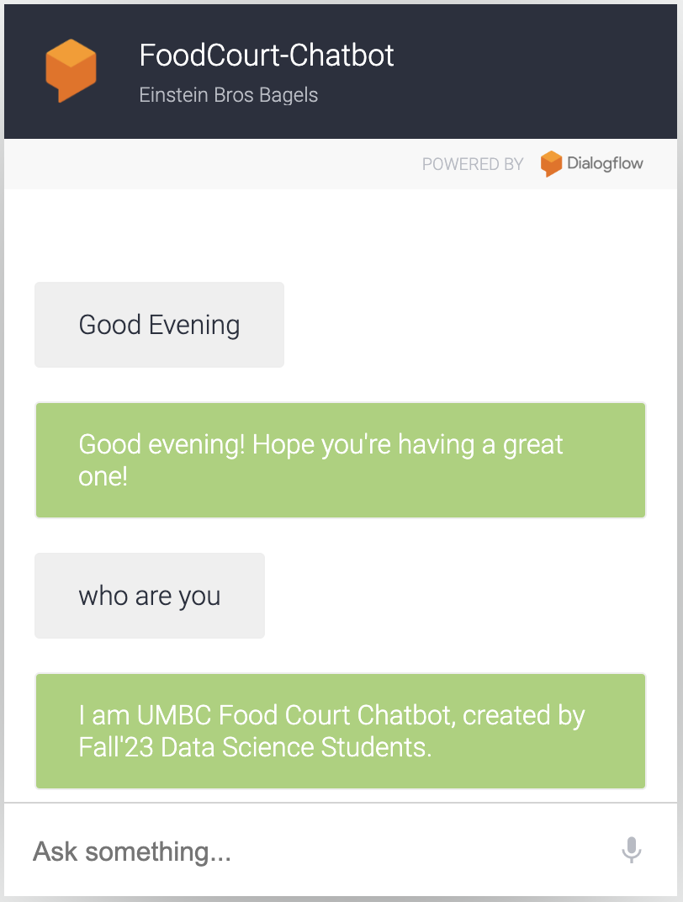
Food court - Chatbot
Team members:
Mounika Atmakuri
Sridhar Reddy Maram
Tauseef Taufiq K
Surya Teja Avvaru
GitHub Link: https://github.com/Tauseef-09/DATA606_Capstone_Project

Slide 2
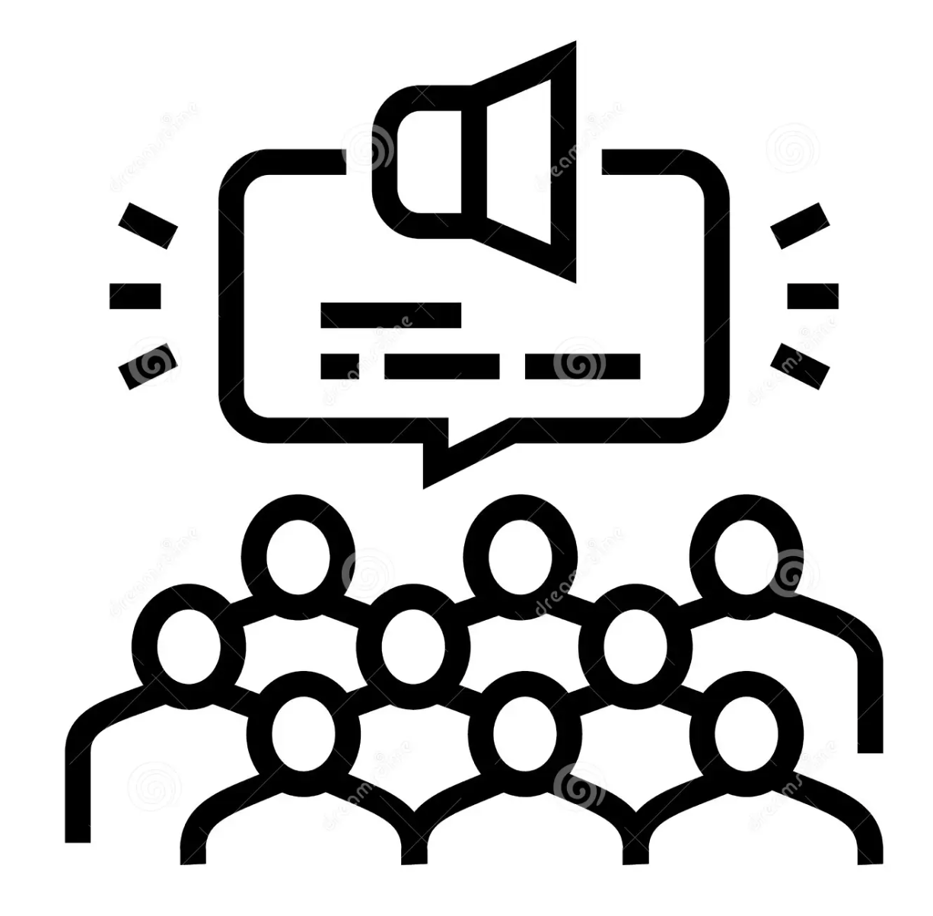
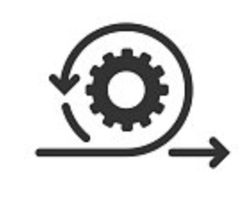


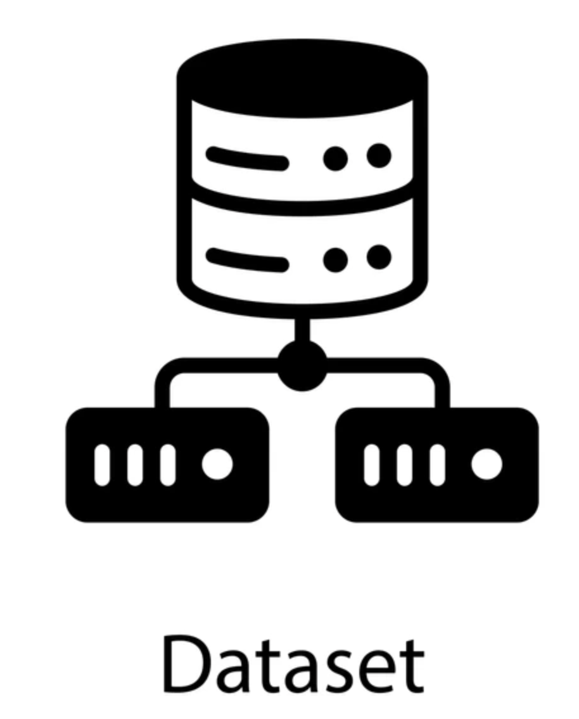
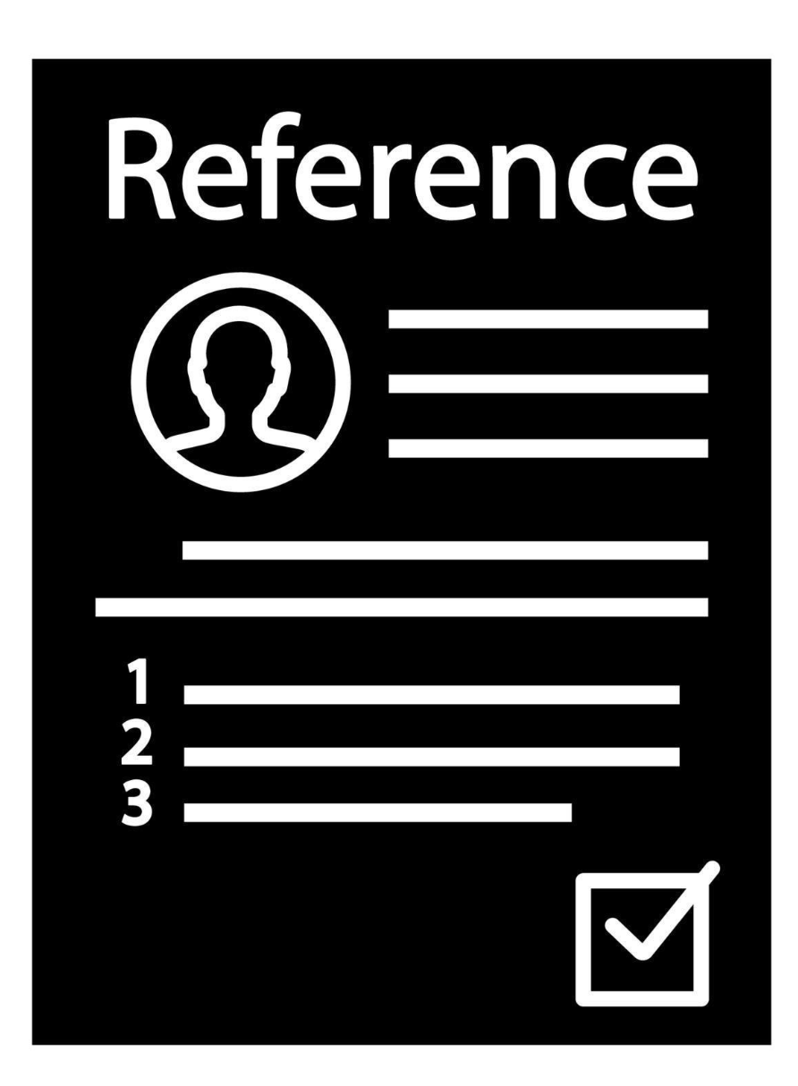



Table of Contents
Introduction
Chatbot Construction & Evaluation
Project Overview Refresher
Literature Survey
Web – scrape using python
Dataset Summary
References
Exploratory Data Analysis (EDA):

Slide 3
Introduction
Our chatbot enhances the food ordering experience through automated interactions.
Provides real-time menu items, prices and ingredient lists.
Integrates NLP with Dialogflow, FastAPI for backend, and MySQL for data management.
Food court -
Chat bot

Slide 4

Project Overview Refresher
Goal: Develop a chatbot for campus food courts to make it easier for users to view menus, prices, nutritional information, ingredients etc…
Technologies: Uses Dialogflow for natural language processing, FastAPI for backend, MySQL for storing data, and a web interface for user interaction.
Data Collection: Menu data was collected manually and will be expanded using web scraping from the UMBC dining website.
Features: The chatbot provides menu details, nutritional information, and helps users to know price of the items.
Performance Metrics: We aim to measure success with task completion rate, intent accuracy, fallback frequency, and response time.
Food court -
Chat bot

Slide 5
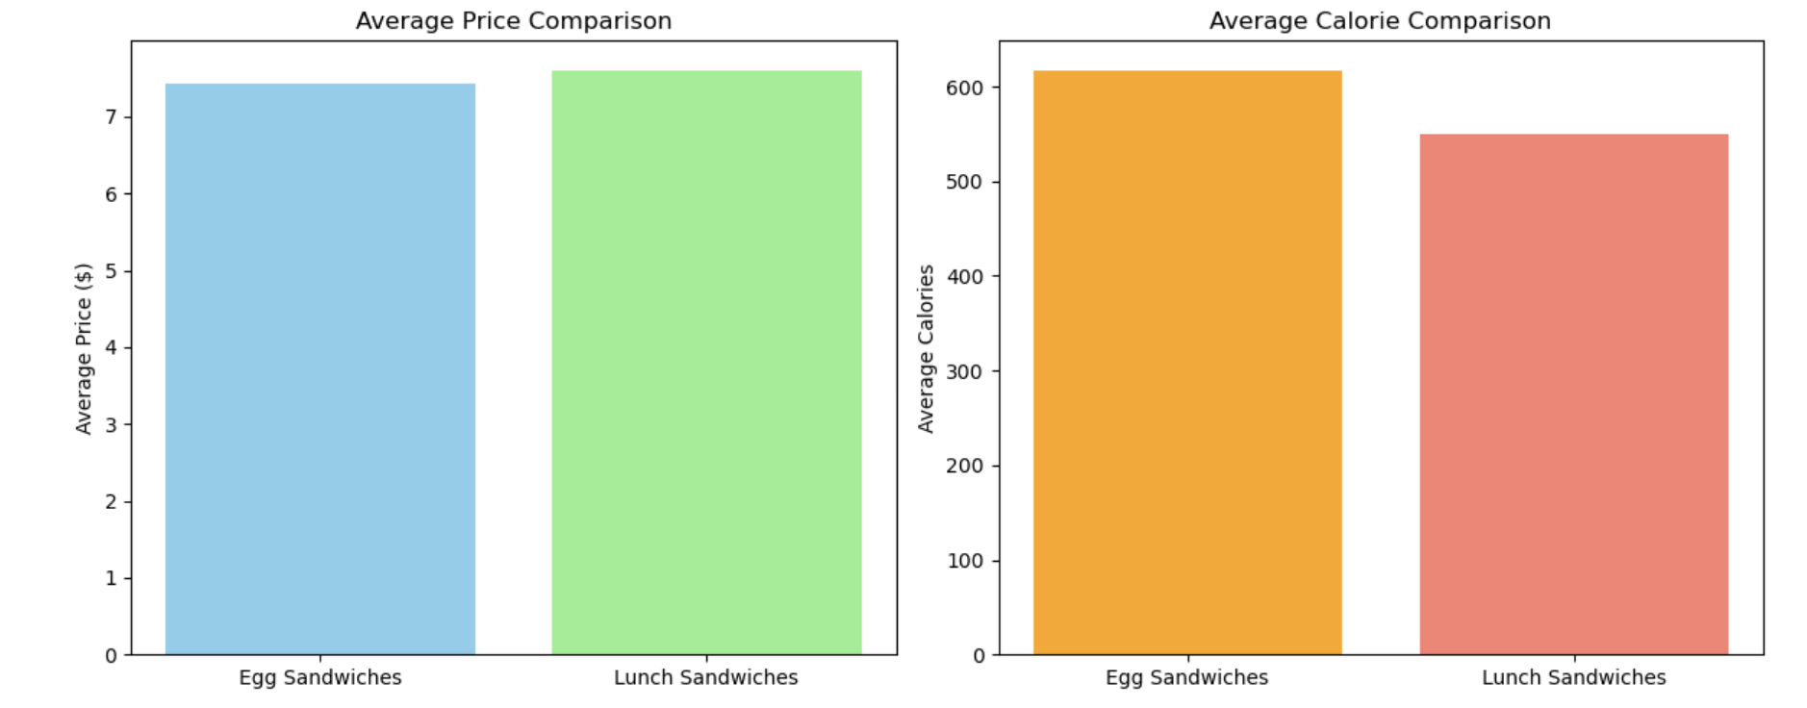
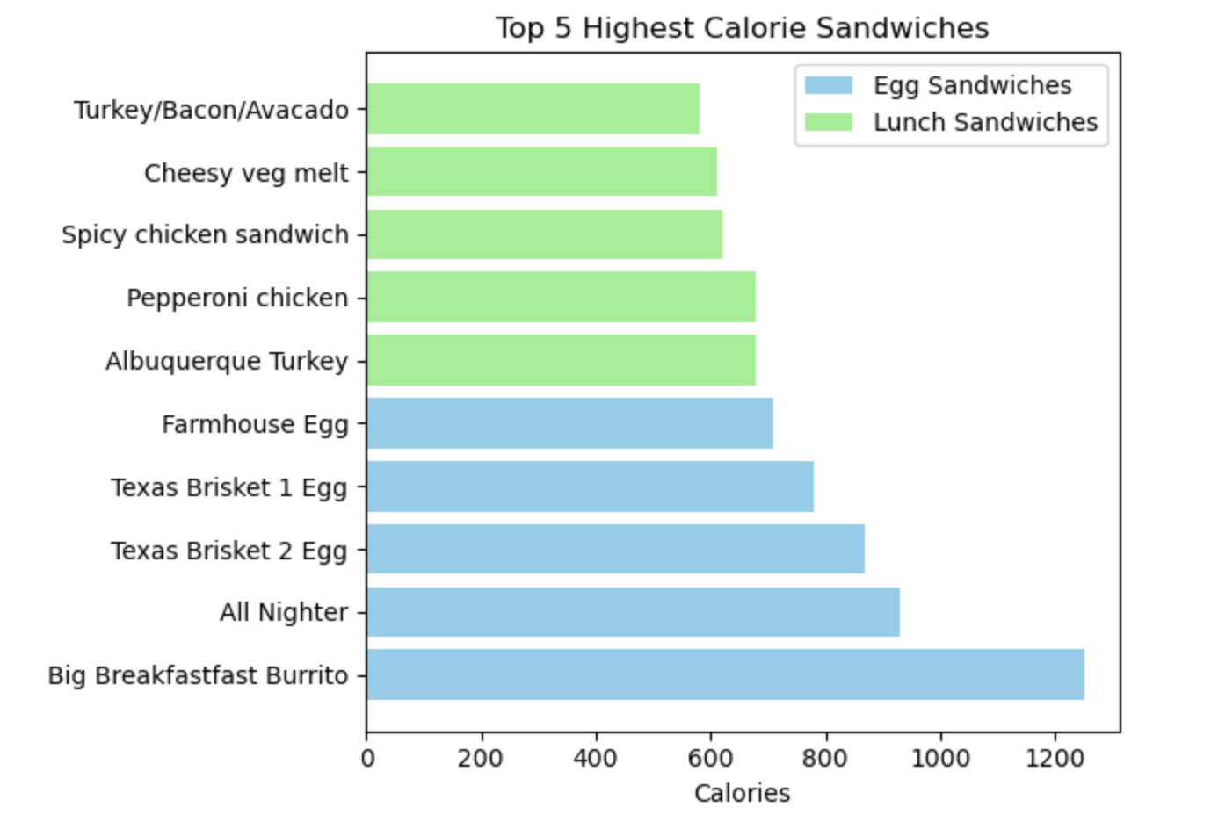
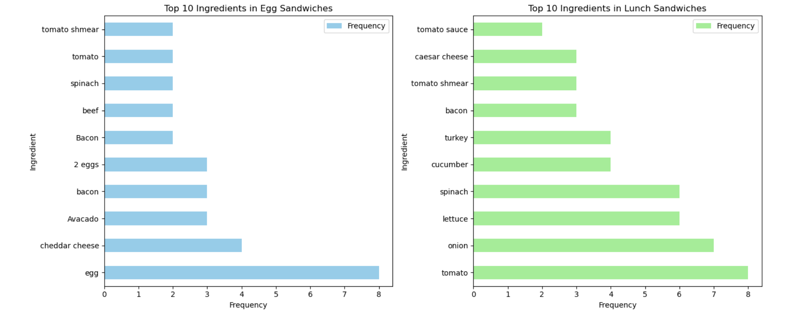
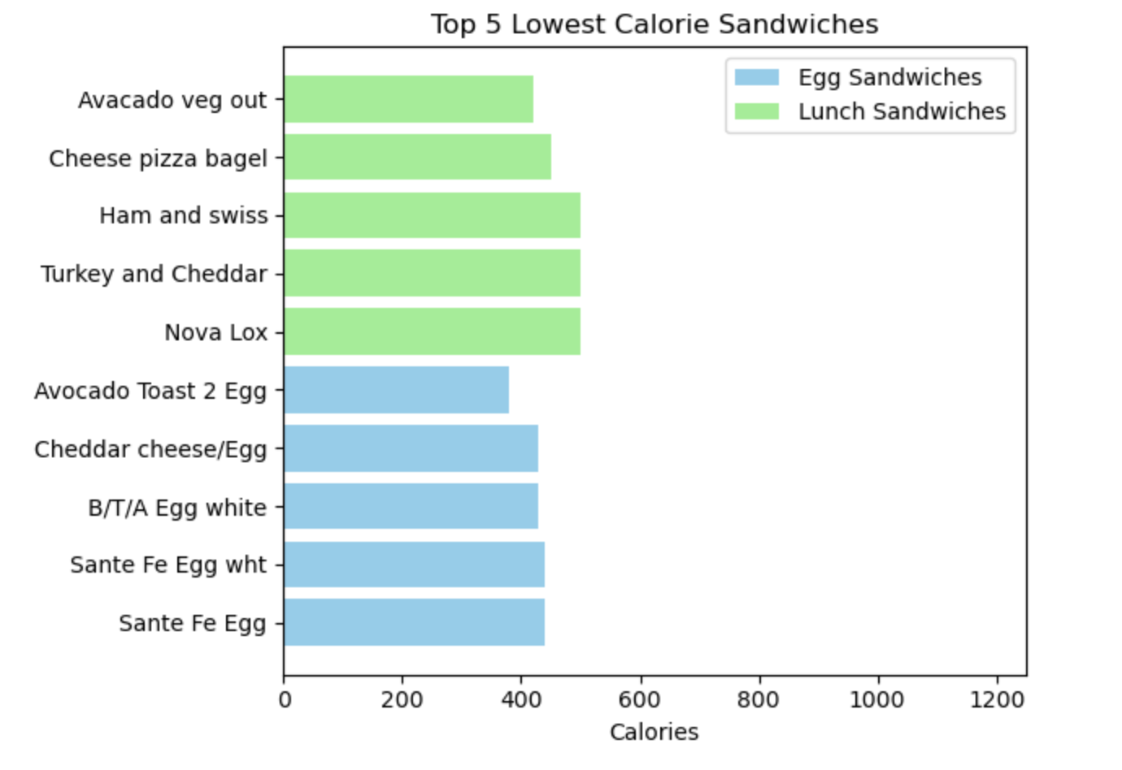
Dataset Summary
Source:
Web scraping from [dineoncampus.com/UMBC](https://dineoncampus.com/umbc) and manual collection.
Data Set:
Categories: Sandwiches, Drinks, Grab and Go, Desserts, Meal Deals, etc.
Attributes: Name, category, price, nutritional information, availability.
Dataset Size: Approximately 100 Food item types collected.
Food court -
Chat bot

Slide 6
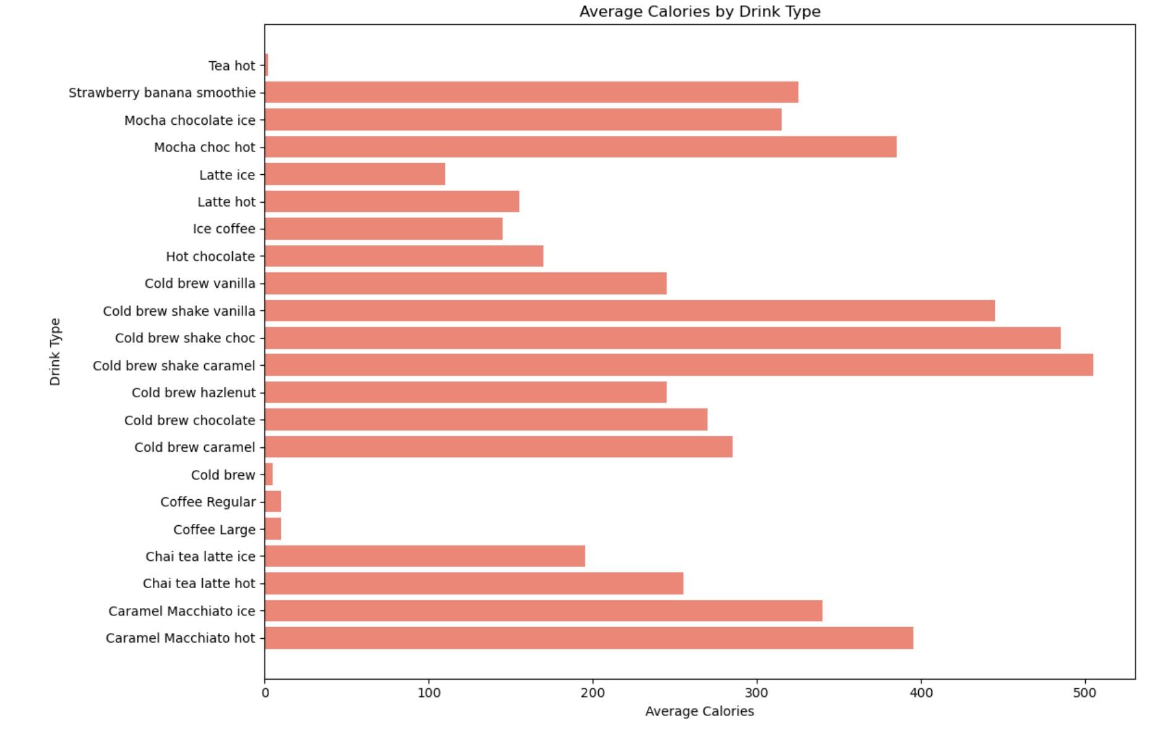
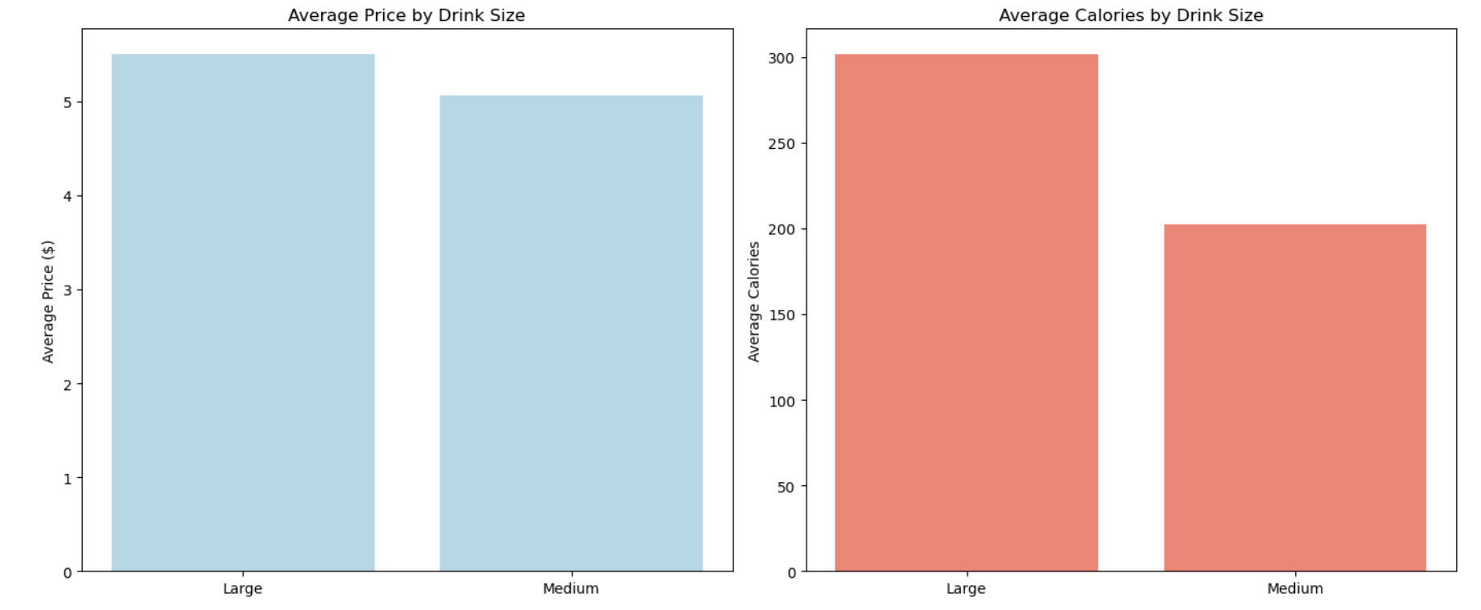
Exploratory Data Analysis
Food court -
Chat bot

Slide 7


Exploratory Data Analysis
Food court -
Chat bot

Slide 8
Chatbot - Construction
Technologies Used:
Dialogflow: NLP for intent recognition (e.g., menu queries, prices)
FastAPI: Backend framework to process API requests and webhooks.
MySQL: Stores menu and it’s related data etc.
Web Interface: Allows users to interact with the chatbot seamlessly.
Food court -
Chat bot

Slide 9
Technologies used in DialogFlow
NLP: BERT – BERT analyzes word relationships to understand the context of user queries.
Machine Learning:
1) TensorFlow
2) Reinforcement Learning
Speech Recognition: WaveNet generates human-like speech, improving conversational experiences.
Cloud Infrastructure: Google Cloud – Google Cloud provides scalable resources for Dialogflow’s operations and integrations.
Multilingual Support: By integrating Google Cloud Translation API, Dialogflow can support conversations in multiple languages.
Food court -
Chat bot

Slide 10
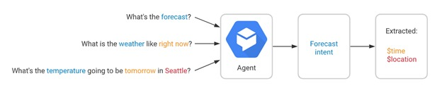
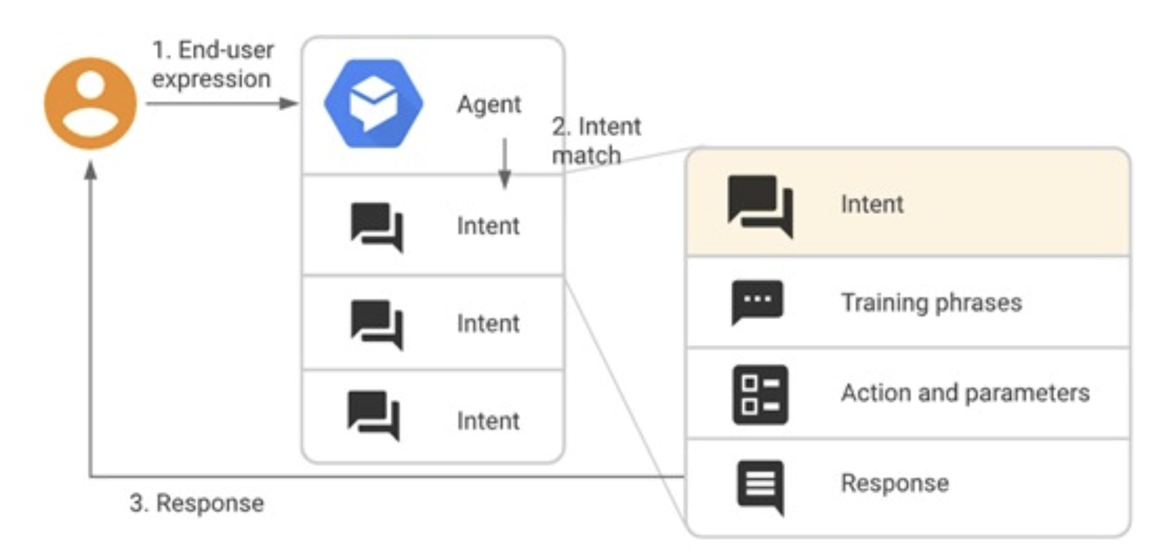
DialogFlow
Food court -
Chat bot

Slide 11
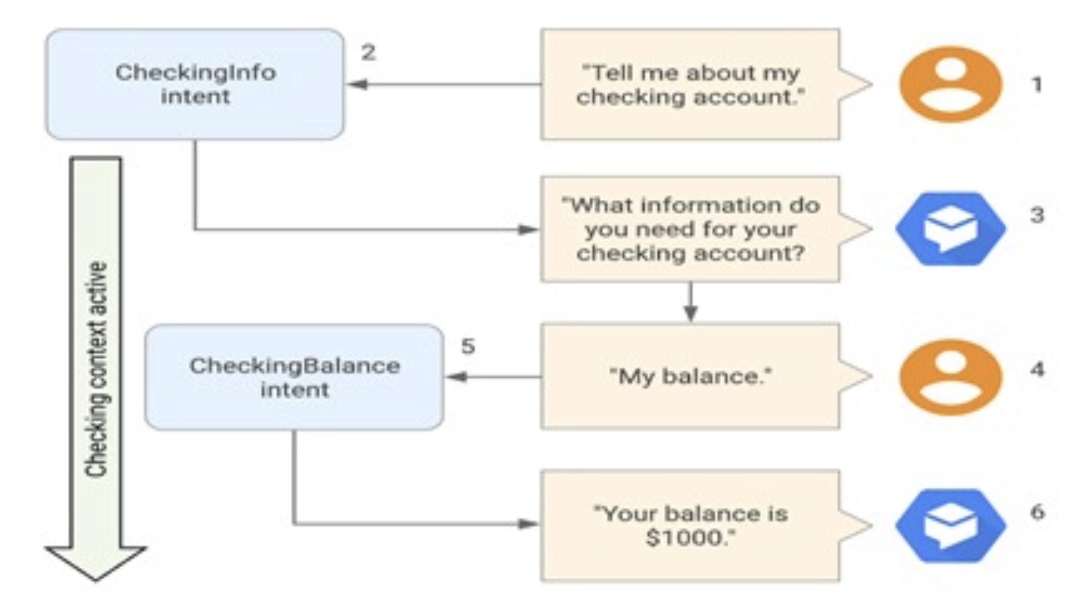
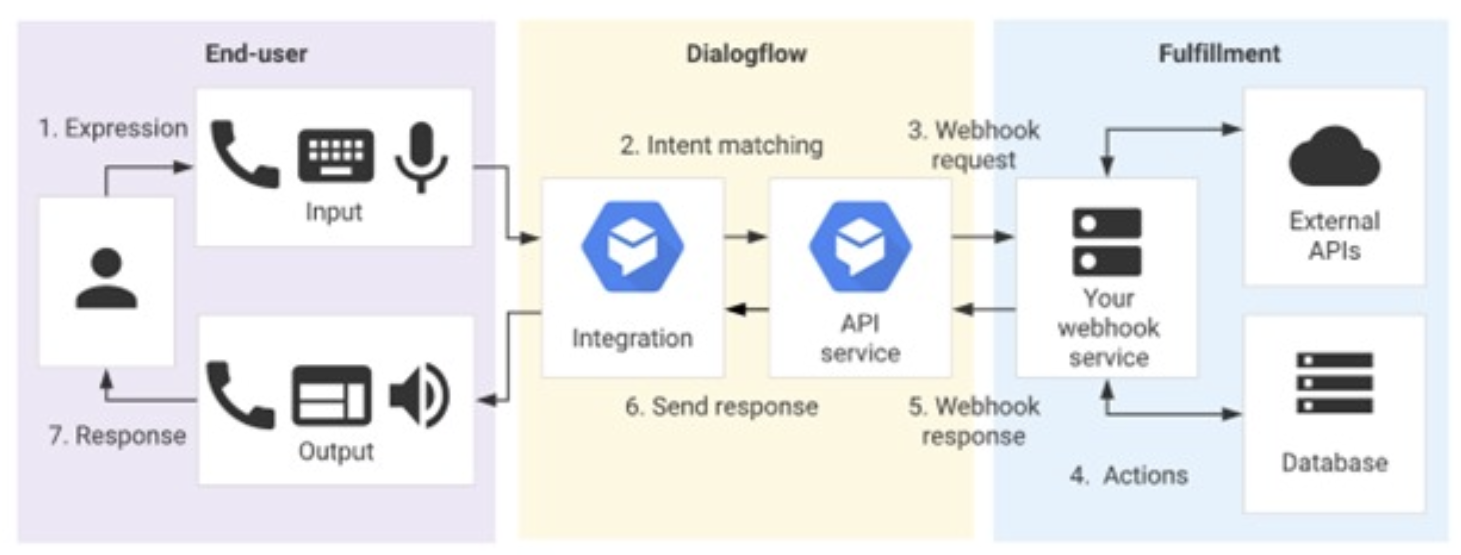
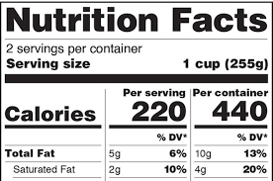
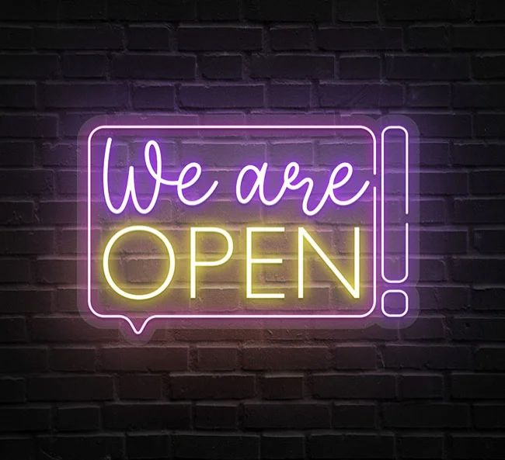
DialogFlow
Food court -
Chat bot

Slide 12
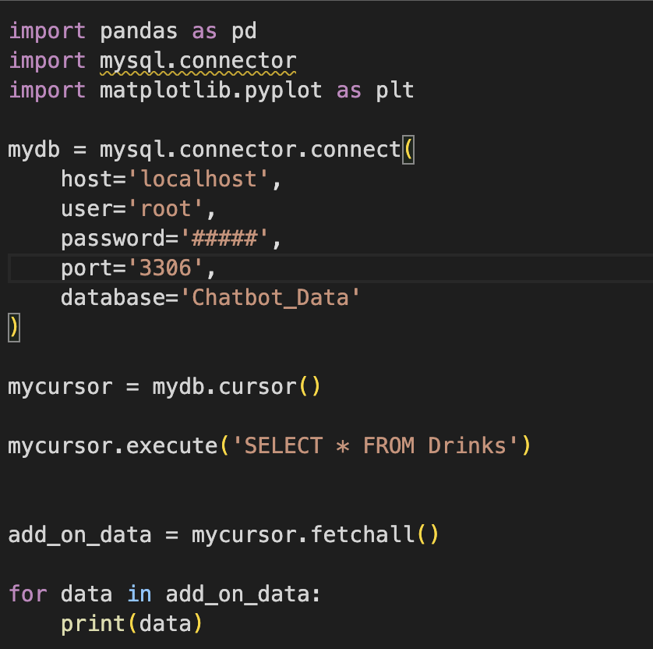
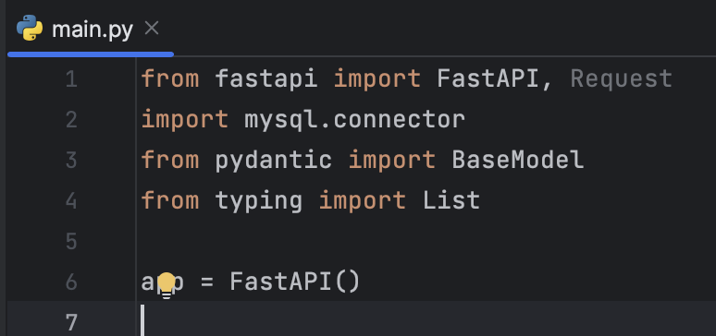
Fast-API & MySQL Connector
Food court -
Chat bot

Slide 13
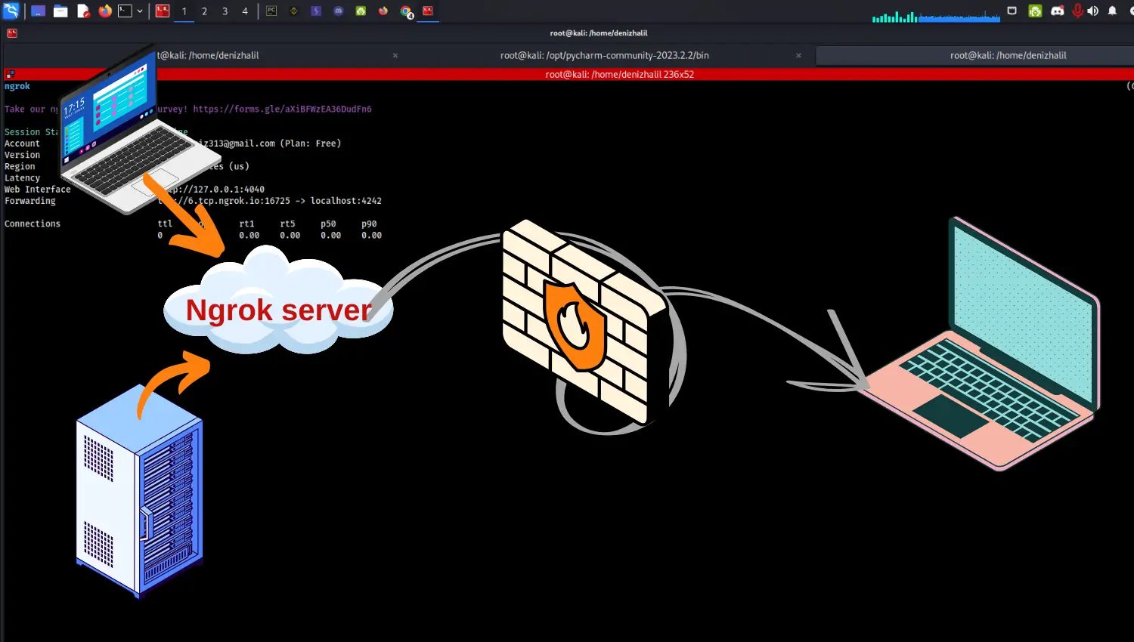
ngrok server
Food court -
Chat bot
brew install ngrok
ngrok config add-authtoken 2ncP2o8STEkCpaHxUFnCYEJB_YAyMxhthuyN3xkUGbC
ngrok http http://localhost:8000

Slide 14
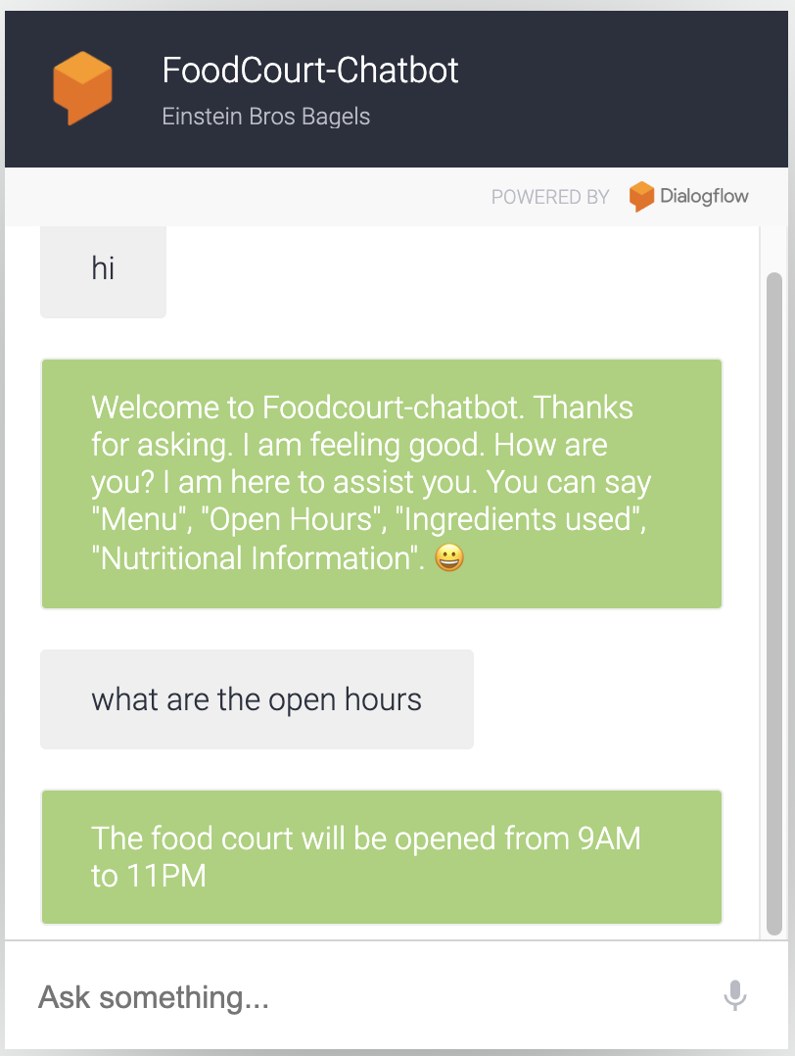
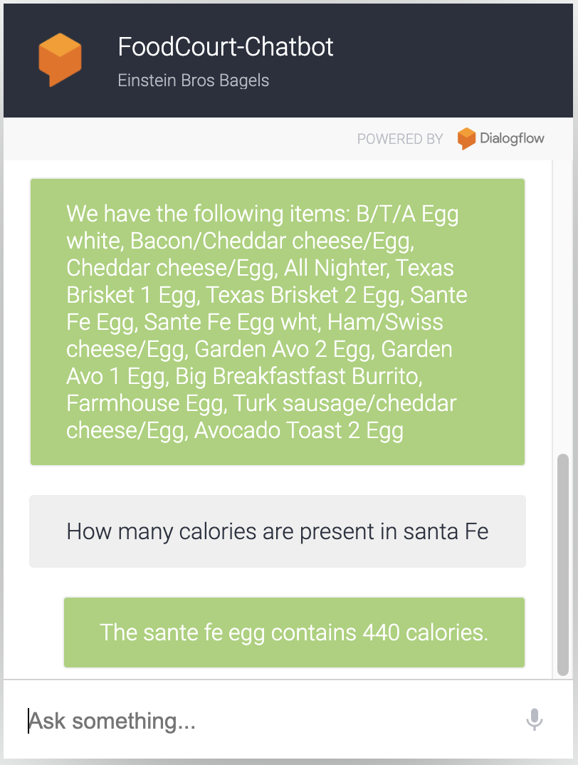
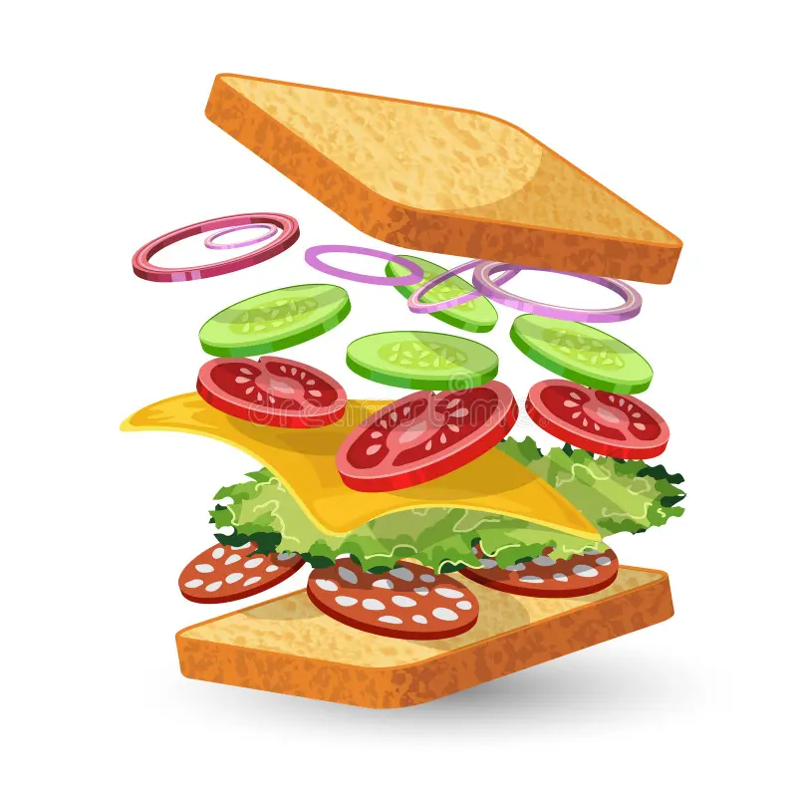
Chatbot Interactions
Food court -
Chat bot

Slide 15
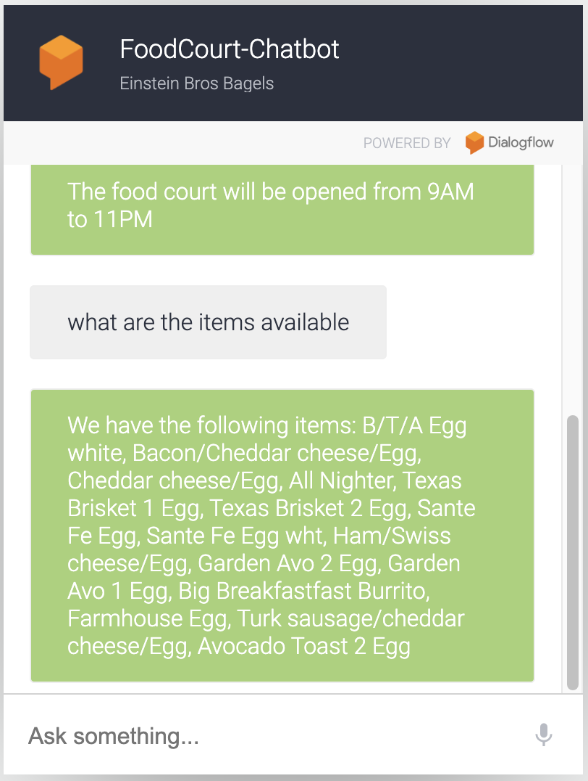
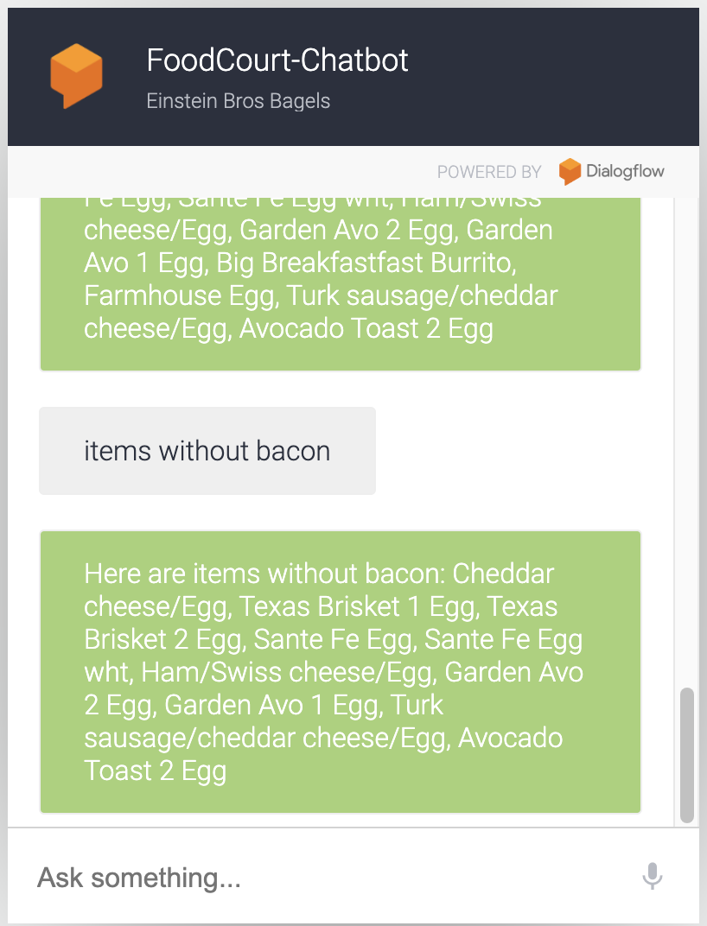
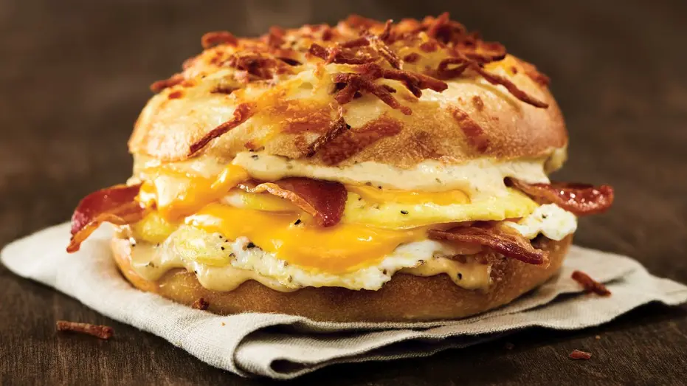
Chatbot Interactions
Food court -
Chat bot

Slide 16
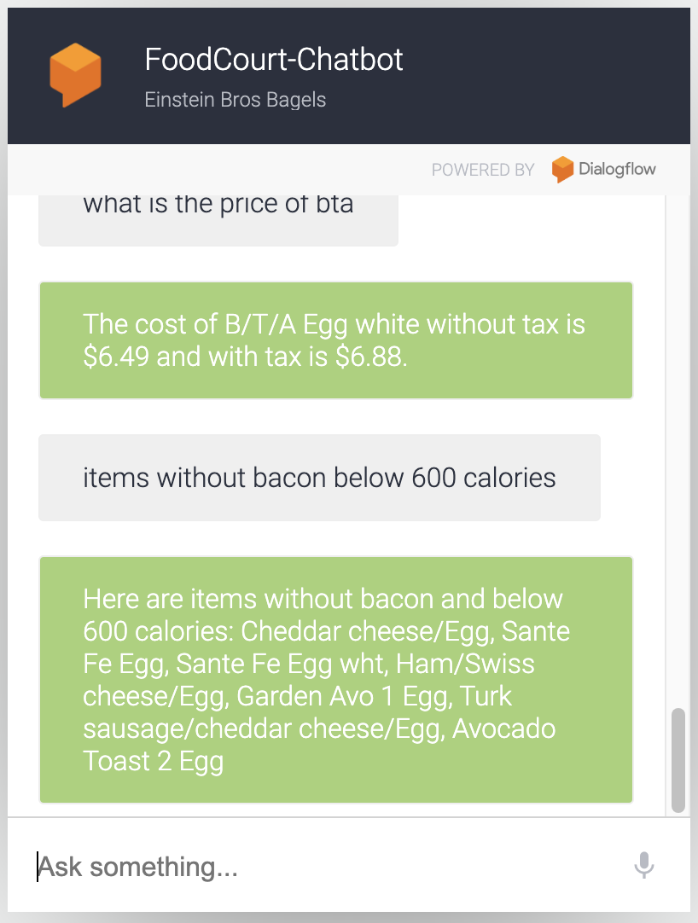
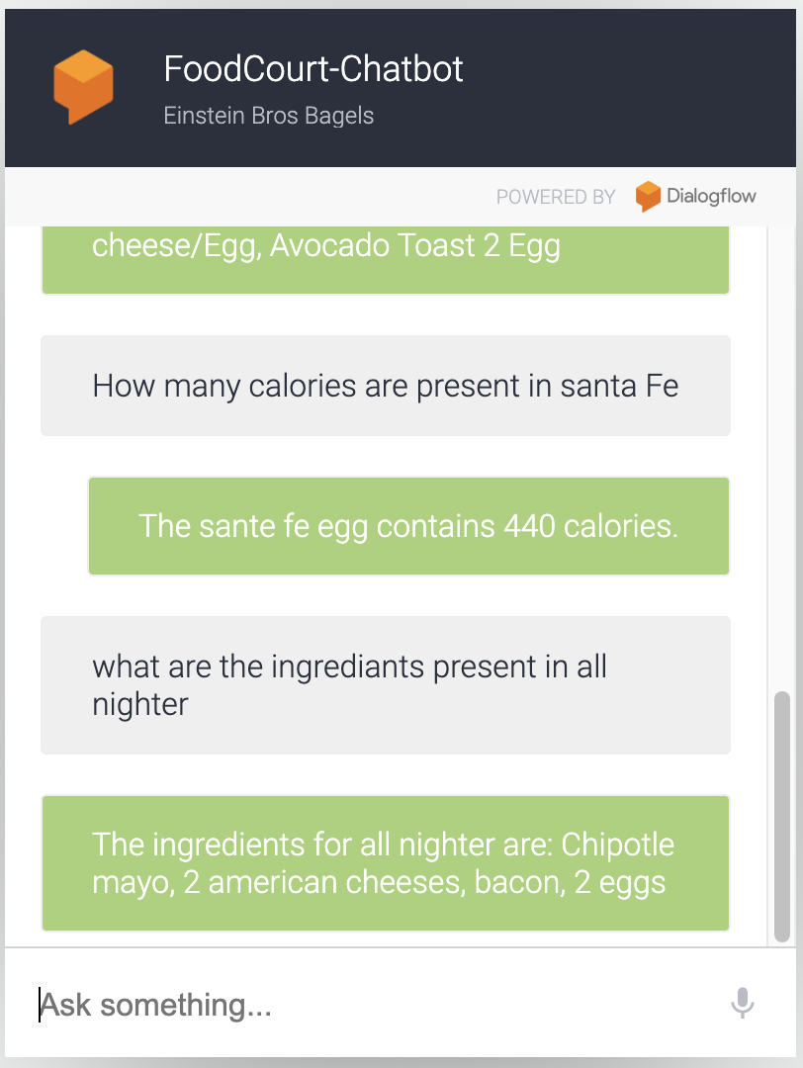

Chatbot Interactions
Food court -
Chat bot

Slide 17
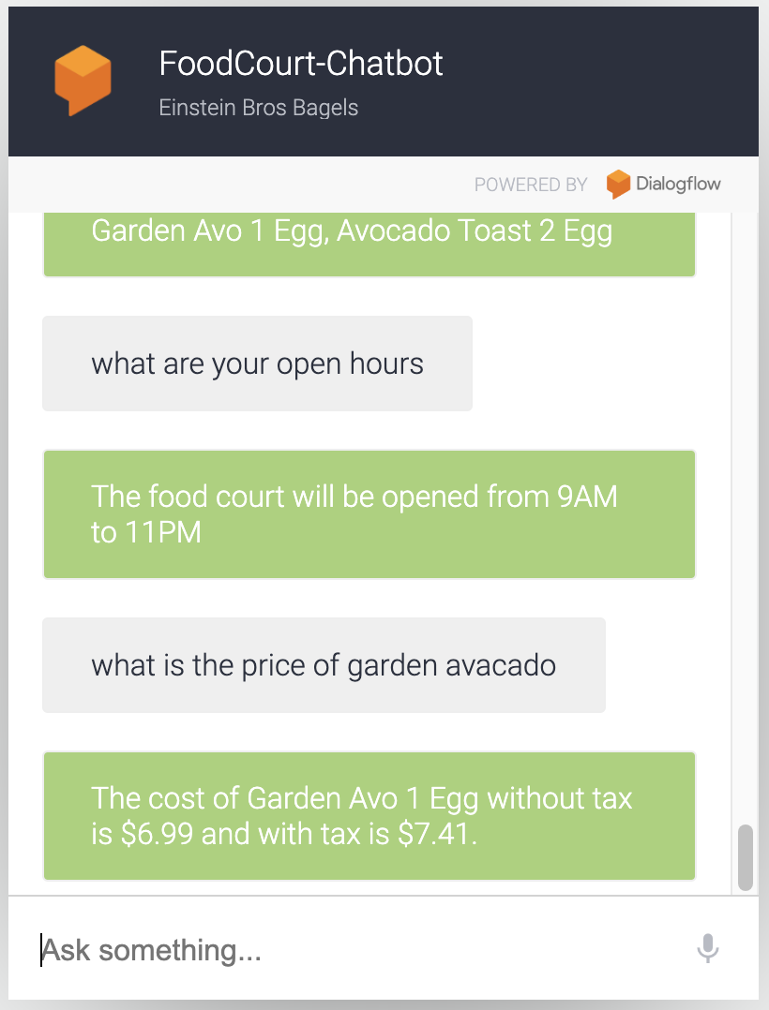
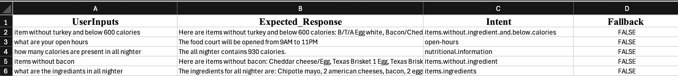
Chatbot Interactions
Food court -
Chat bot

Slide 18

Chatbot - Evaluation
How chatbot will be evaluated:
Pull logs from Dialogflow, extracting key data points: queryText (user question), fulfillment (chatbot response), displayName (intent), isFallback (fallback indicator), and webhook_latency_ms (latency).
Save this data into a CSV file for analysis.
Food court -
Chat bot

Slide 19
Chatbot - Evaluation
Compare the extracted data with known intents, fallback instances, and expected fulfillments using a Python script.
Calculate evaluation metrics: Task Success Rate, Intent Classification Accuracy, Fallback Rate, and Response Time.
Analyze and interpret the results to identify areas for improvement in the chatbot’s performance.
Food court -
Chat bot

Slide 20
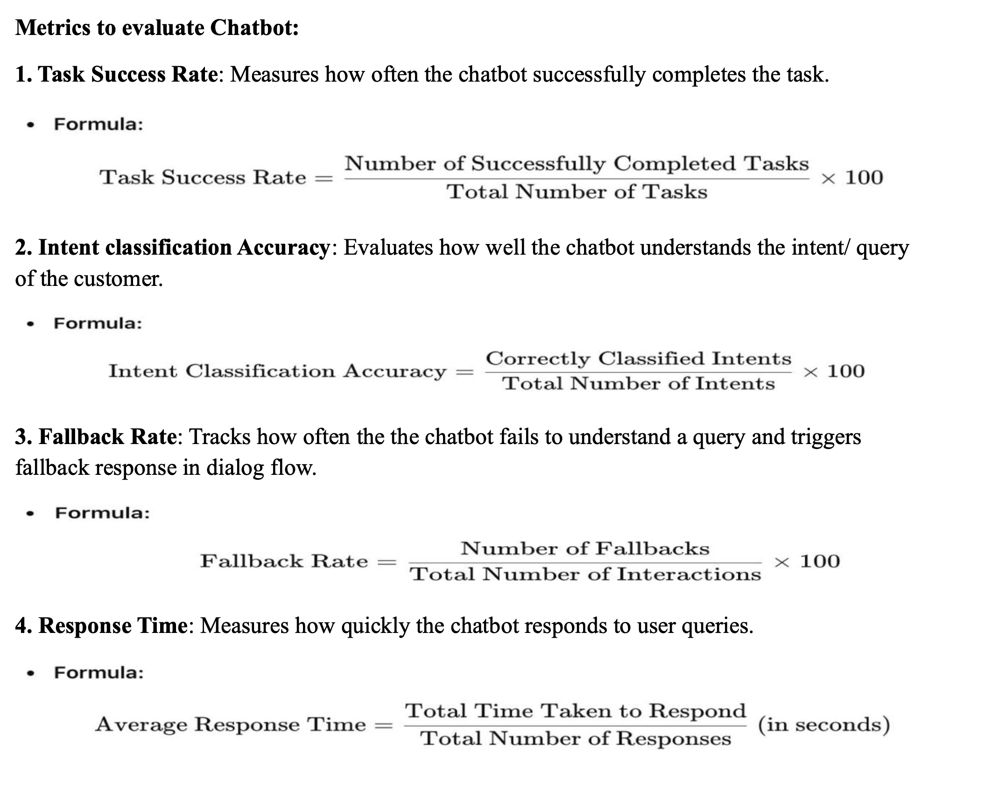
Chatbot - Evaluation
Food court -
Chat bot

Slide 21
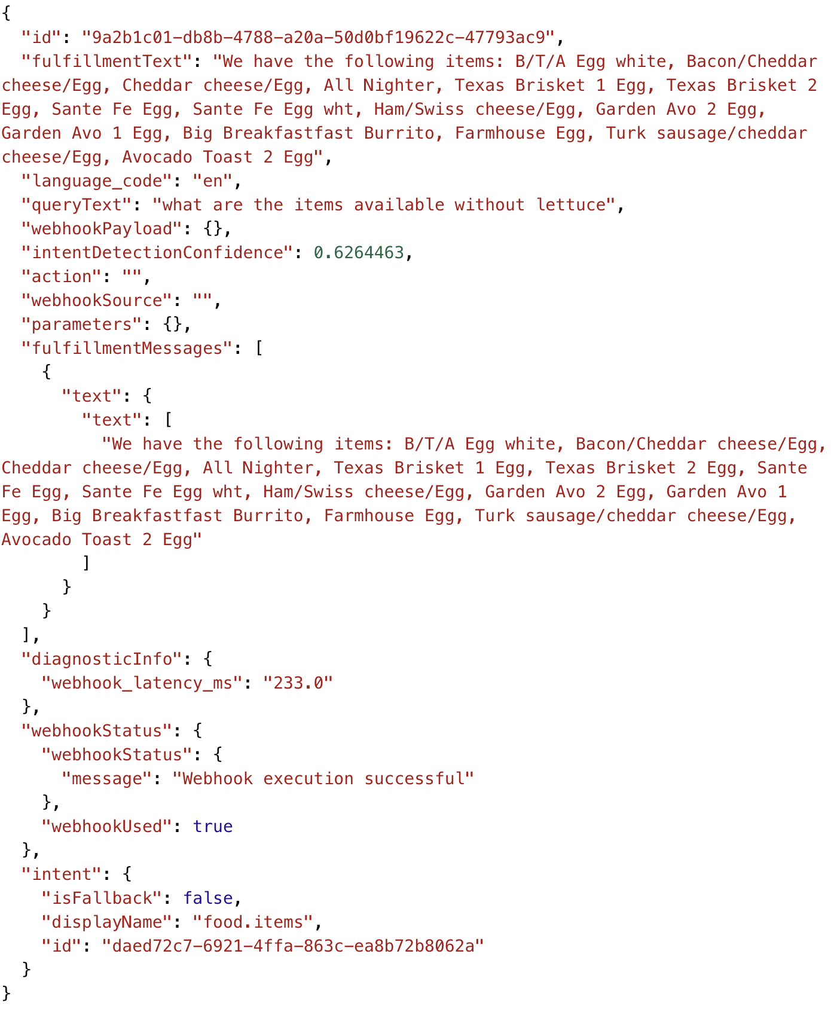
Chatbot - Evaluation
Food court -
Chat bot
This is a JSON query/response log of the chatbot from which necessary metrics are fetched.

Slide 22
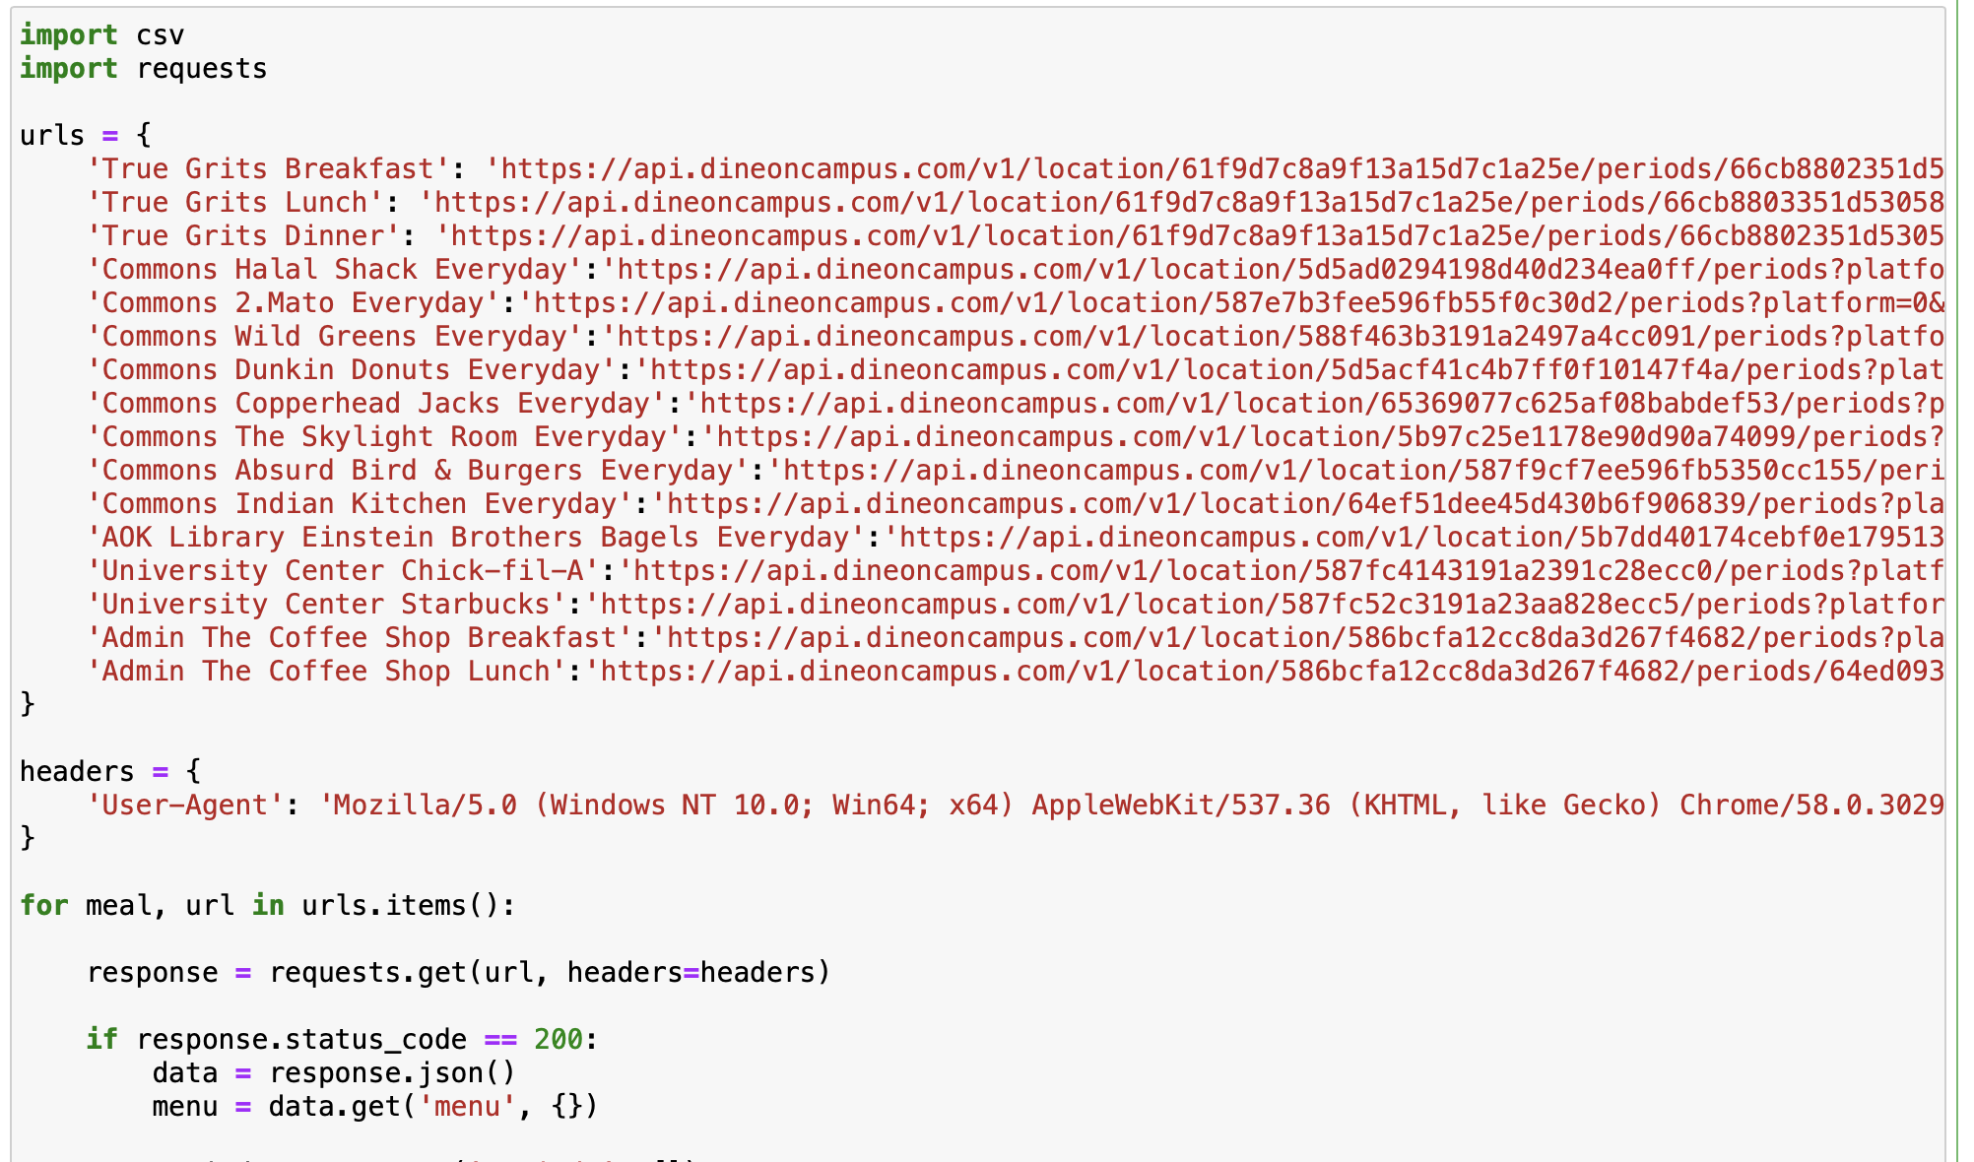
Web – scrape Using Python
Food court -
Chat bot

Slide 23
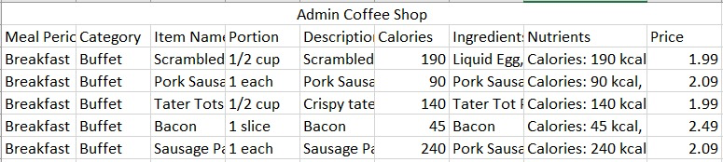
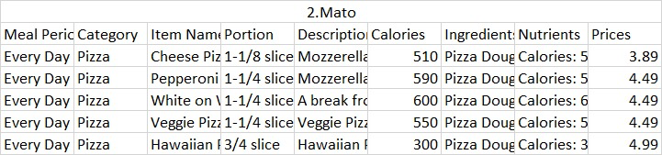
Web – scrape Using Python
Food court -
Chat bot

Slide 24
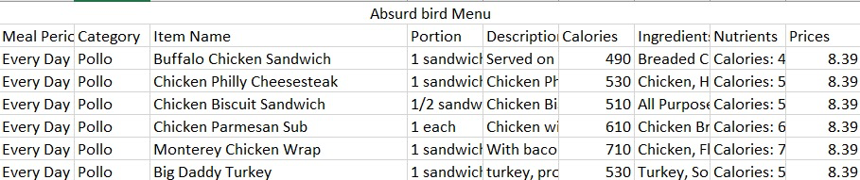
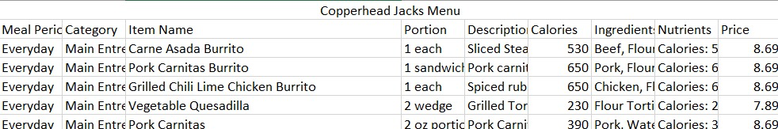
Web – scrape Using Python
Food court -
Chat bot

Slide 25
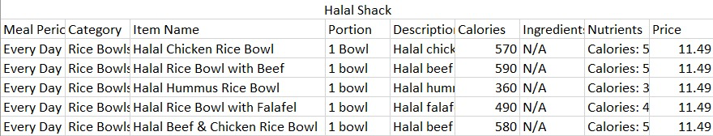
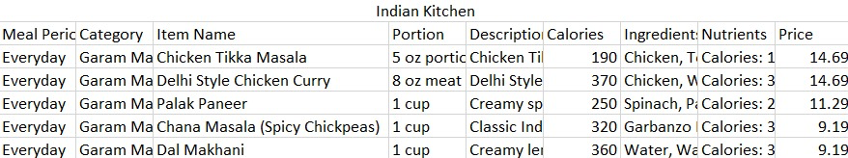
Web – scrape Using Python
Food court -
Chat bot

Slide 26
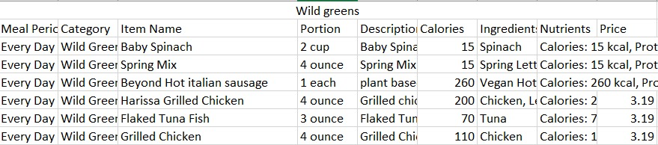
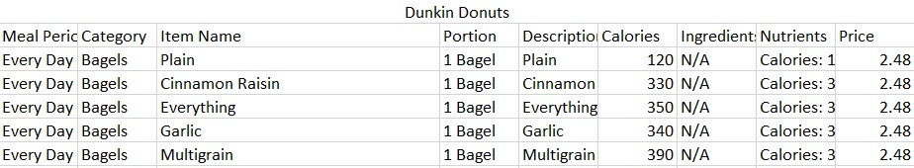
Web – scrape Using Python
Food court -
Chat bot

Slide 27
Literature Survey
Related Works:
Mr. Hungry Chatbot: CSV-based meal recommendation system using NLP.
1) A food chatbot offering personalized meal suggestions using "Restaurant.csv" and NLP.
2) Combines CSV-based menus, NLP for interactions, and delivery service integration.
Kayo AI Chatbot: Uses NLTK and TensorFlow for food ordering via Telegram.
1) Kayo uses NLTK, TensorFlow, and Telegram to present menus and handle orders.
2) Python scripts, JSON menus, NLP modules, and Telebot for real-time interaction.
Food court -
Chat bot

Slide 28


References
GitHub: [Mr. Hungry Chatbot](https://github.com/AhmadYasser1/Food-Recommending-Chatbot)
GitHub: [Kayo AI Chatbot](https://github.com/yenxuan1381/food-ordering-chatbot-using-ai)
Food court -
Chat bot

Slide 29
